Slide 1
EMOJI EXPRESSER
Team Mates:
Akhila Vidya Sriya Dornipadu
Mustafa Abuthuraya
Saranya Haridass

Slide 2
WHY EMOJIS?
We had a common interest towards animation, so our go to idea was to animate Emojis
We planned to create a set of graphically designed animated emojis.
Emojis are interesting, expressive so we can animate them as we like.
Project Emoji POP:
Watch emojis pop and express its feelings as an action is clicked!

Slide 3
WHY ANIMATIONS?
To see the picture have a expression.
To make it look interesting.
Coding is responsible for the animation!!
For example, the water splash.
“Animation is important because it makes us be able to tell stories and communicate emotions and ideas in a unique, easy-to-perceive way that both small children and adults can understand.”

Slide 4
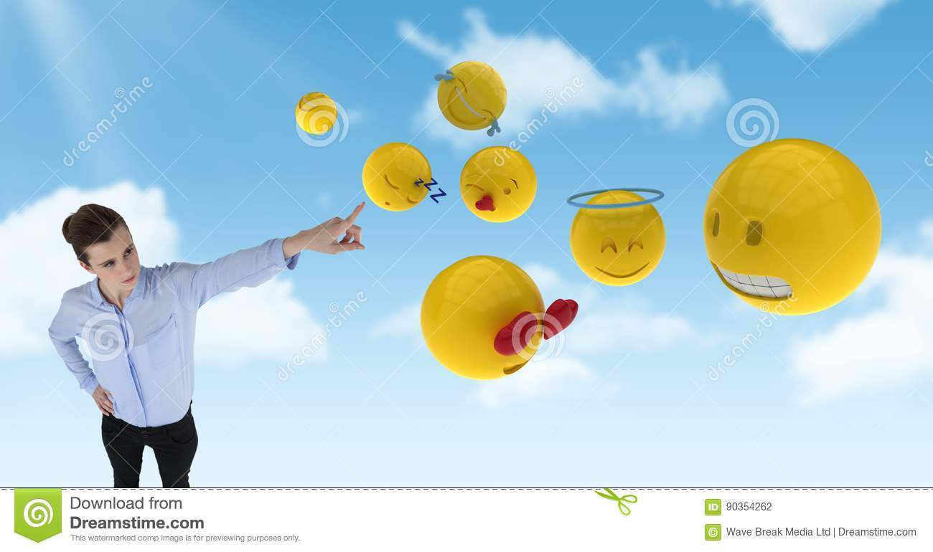
HOW IT LOOKS?
Screen 1: PROJECT TITLE WITH START button.
EMOJI EXPRESSOR
START

Slide 5
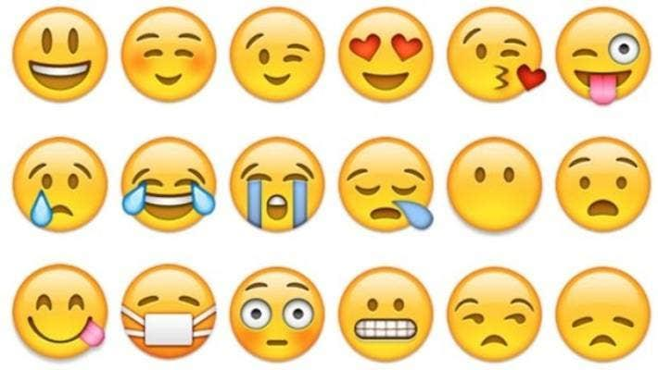
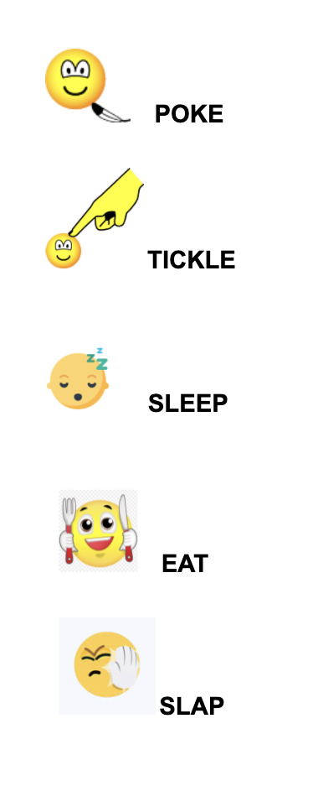
Screen 2: Few catchy emoji with actions!

Slide 6
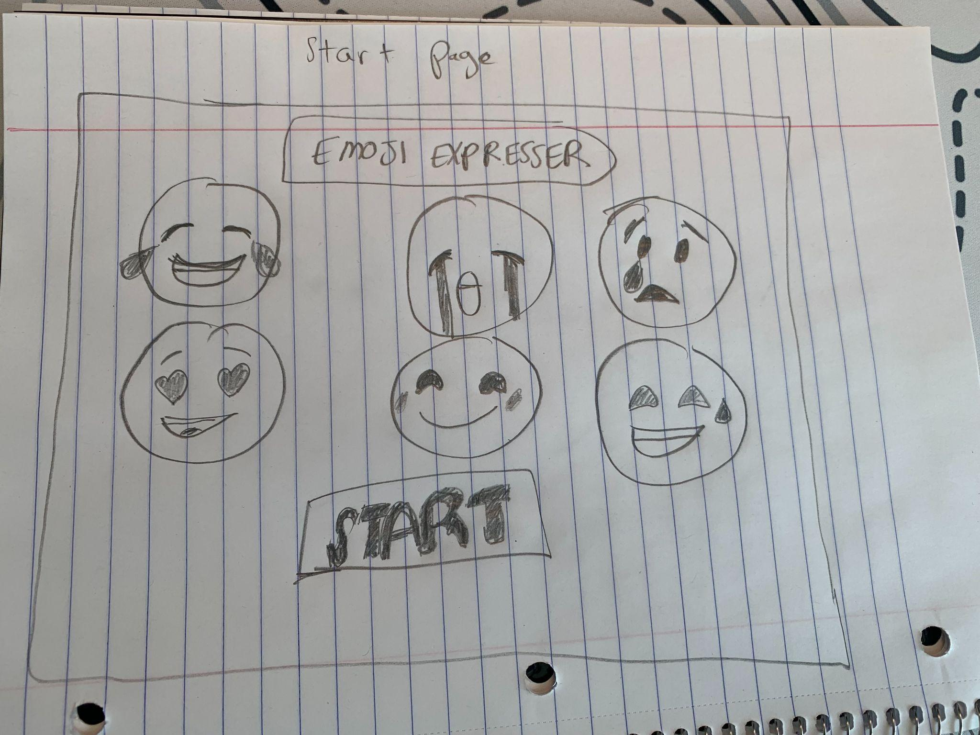
HOW IT WORKS? Home Page

Slide 7
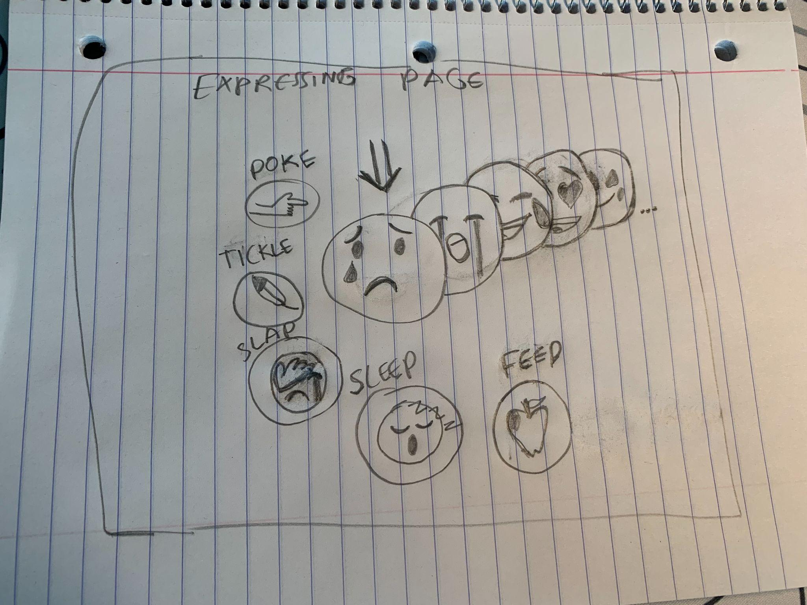
HOW IT WORKS? Step 1

Slide 8
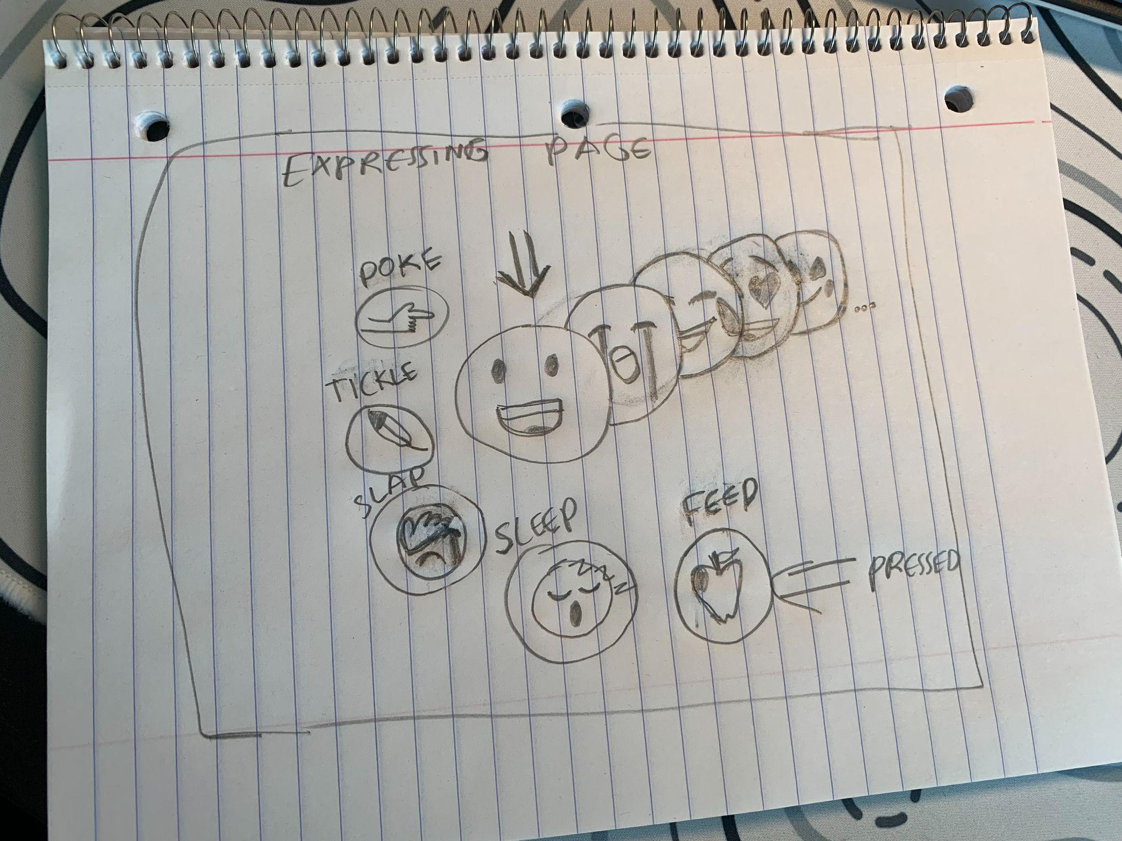
HOW IT WORKS? Step 2

Slide 9
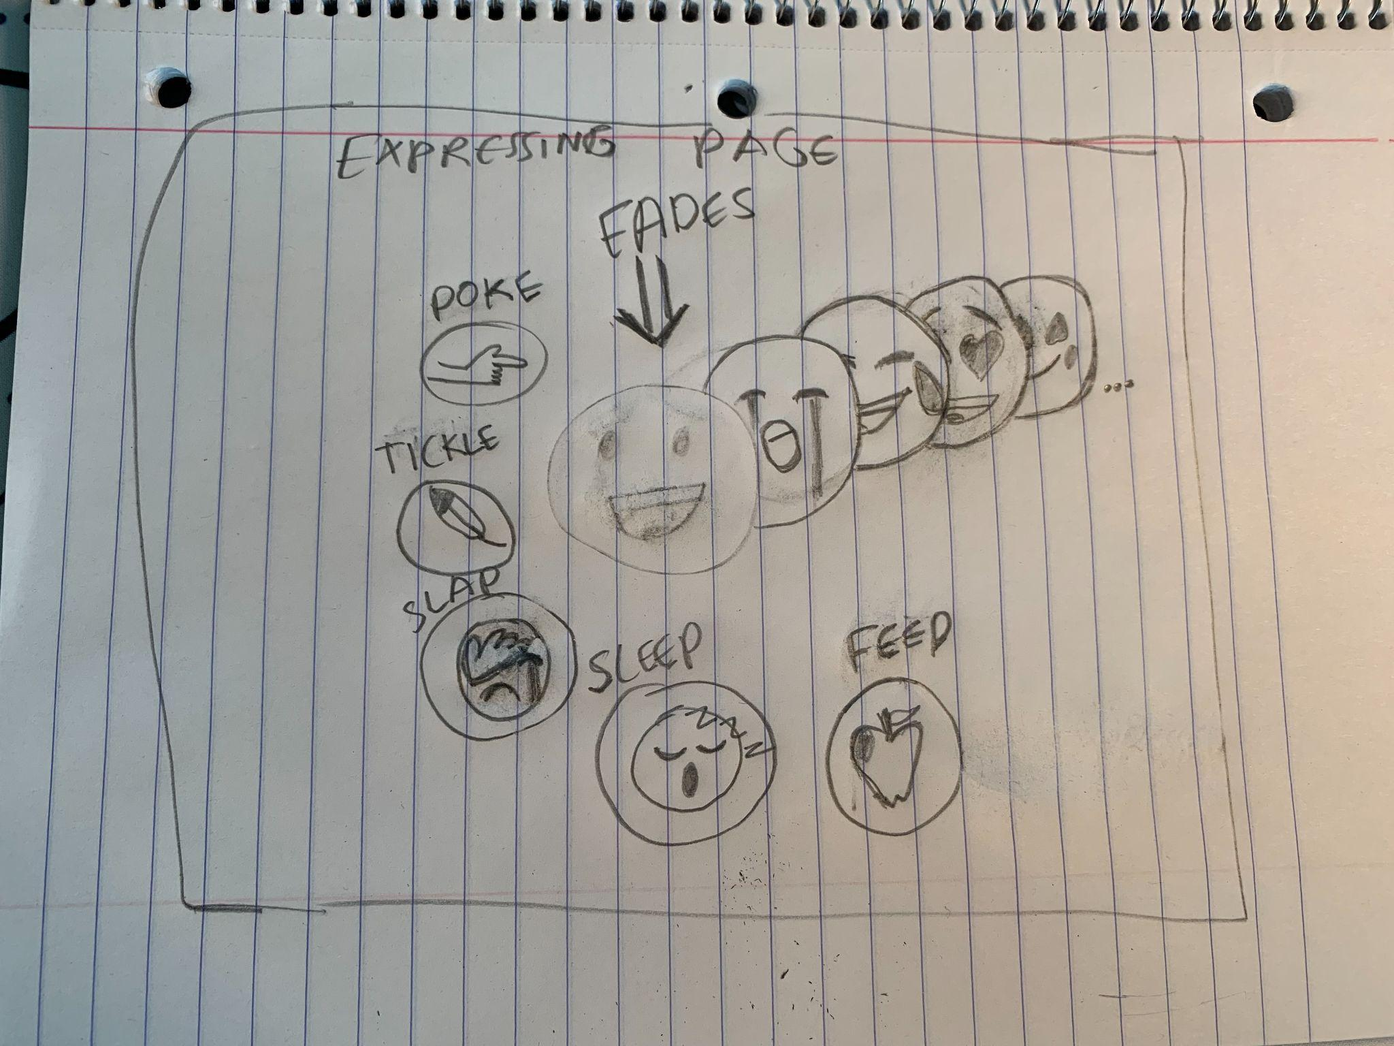
HOW IT WORKS? Step 3

Slide 10
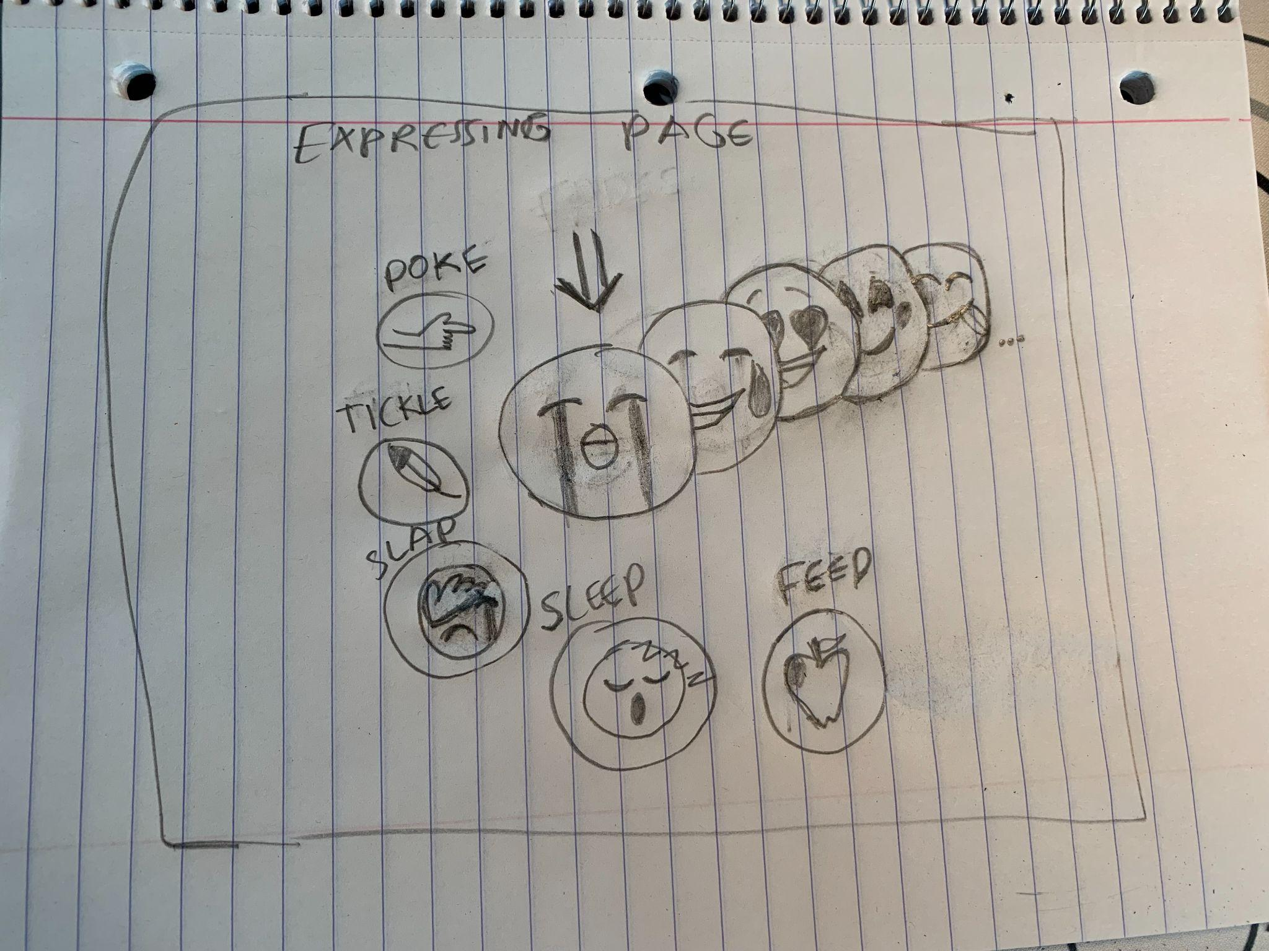
HOW IT WORKS? Step 4

